Slide 1


Slide 2
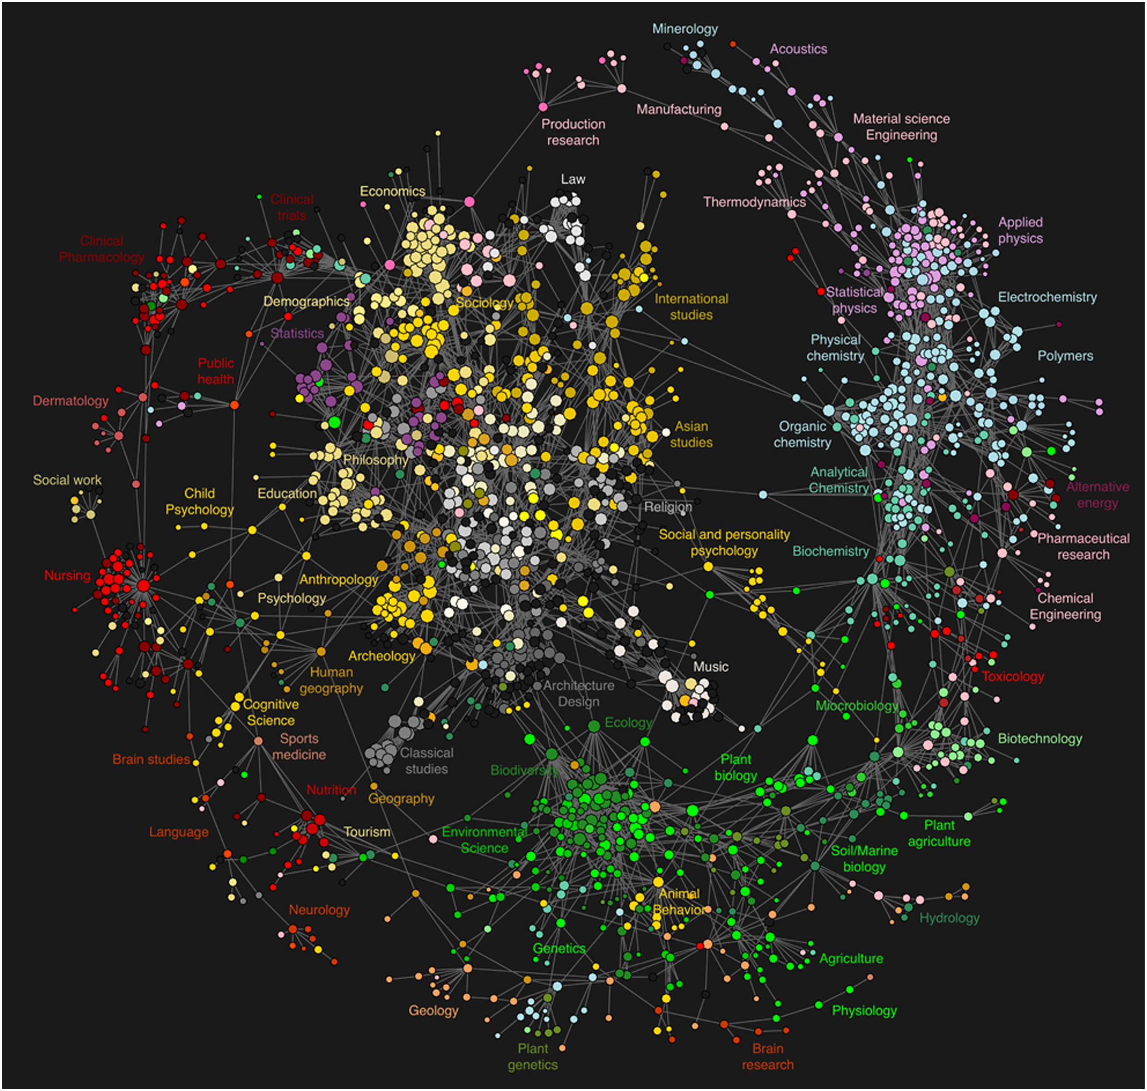
Une nouvelle ère en sciences
Bollen J et al. (2009). PLoS ONE 4(3)

Slide 3

Une nouvelle ère technologique

Slide 4
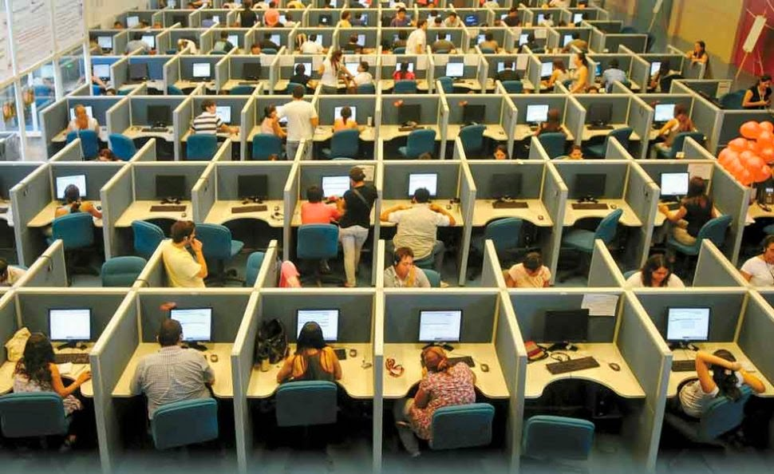
La réalité

Slide 5

Nos outils collaboratifs…
Flickr: AppleDave

Slide 6









Slide 7
1- L’écriture

Slide 8
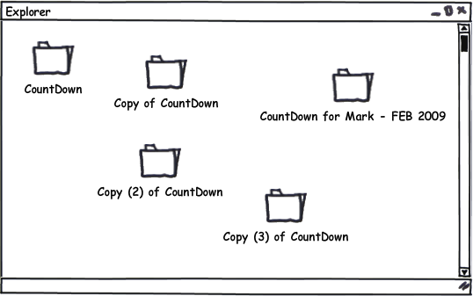
Nos fichier
modified from Benjamin Wilcox on SlideShare

Slide 9





Problèmes émergents à grande échelle…

Slide 10


Problèmes émergents à grande échelle…

Slide 11


Slide 12


Slide 13
Agnostique → Latex, HTML, word
Formate à votre place
3) Inclus: Manuscrit + données + code
4) GIT
5)…

Slide 14
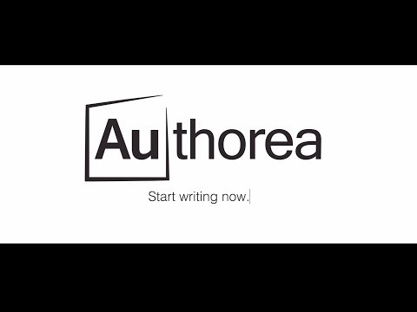

Slide 15


Slide 16
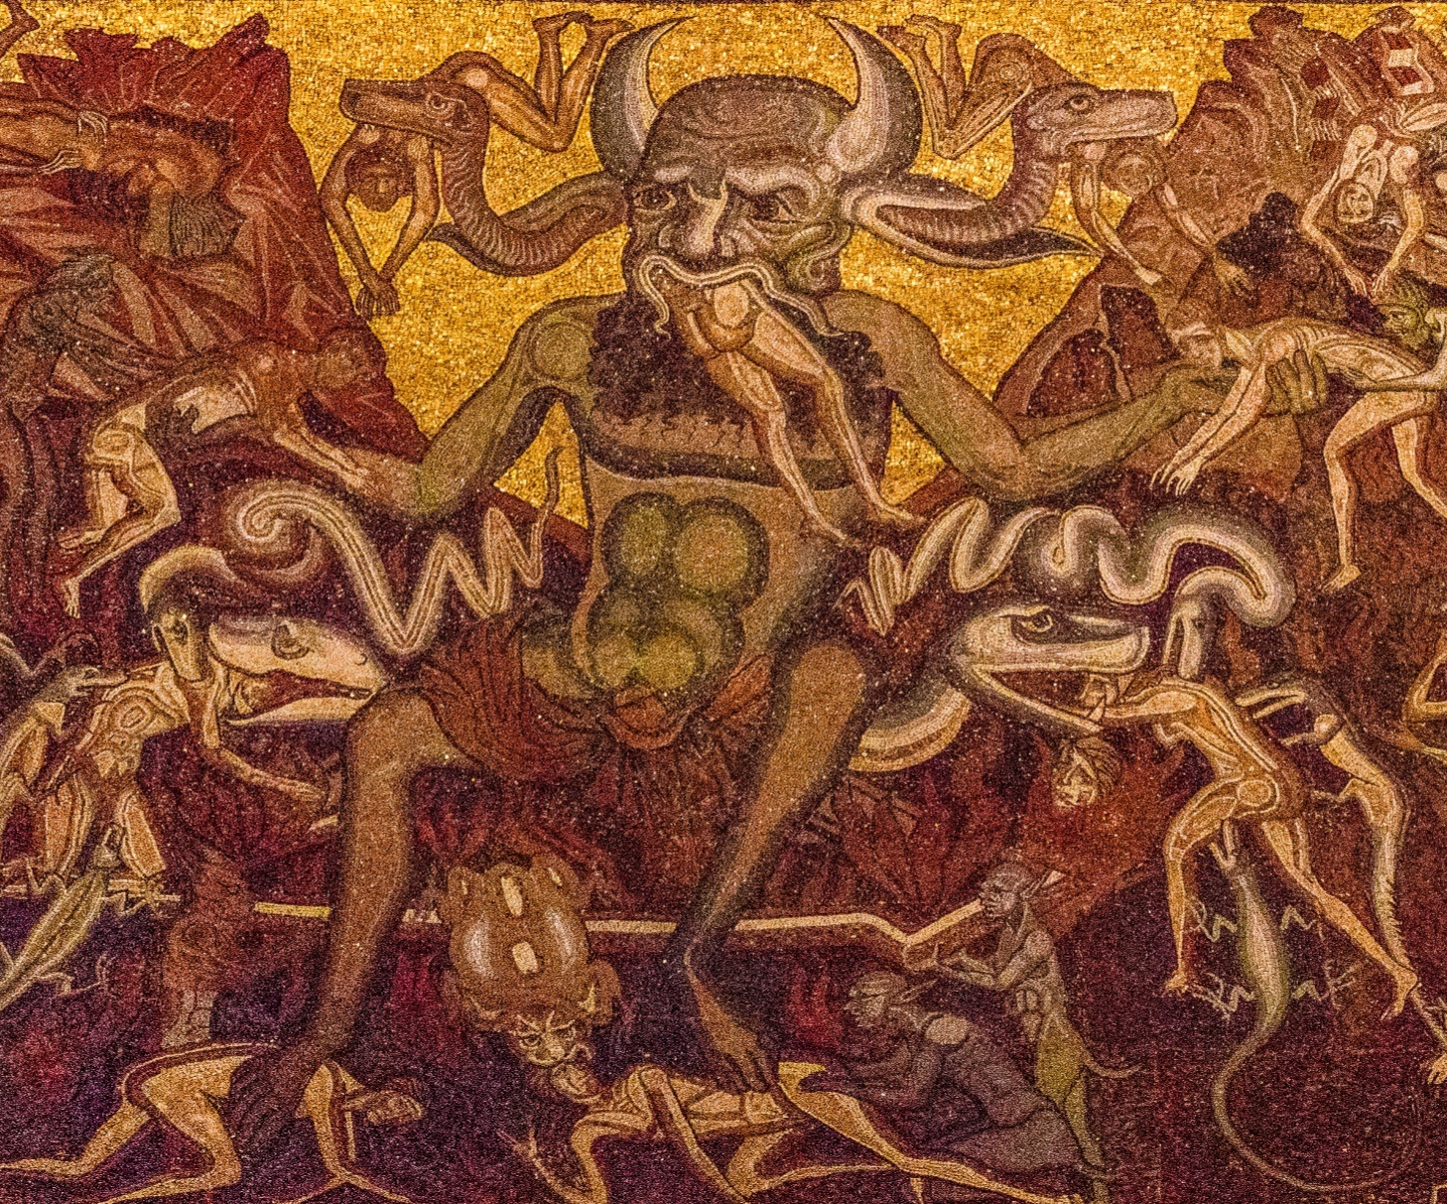
Flickr: Albert

Slide 17
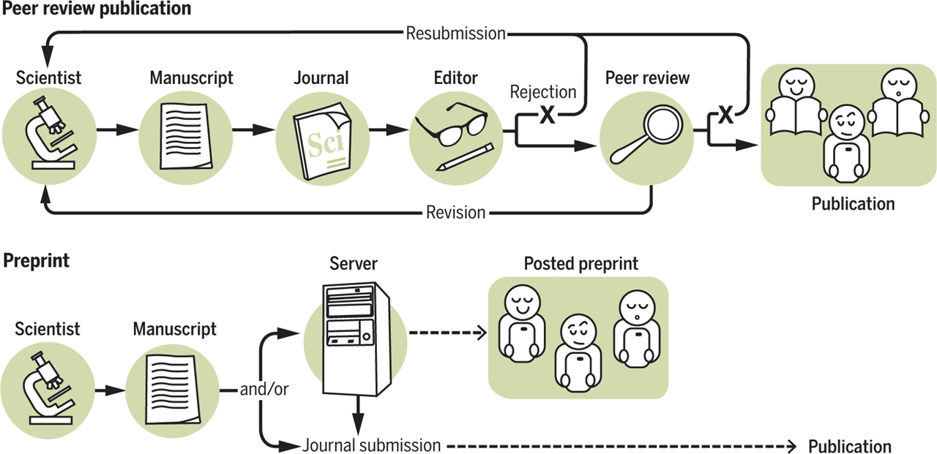
Le processus de publication
Jeremy M. Berg et al. Science 2016;352:899-901
Efficace?

Slide 18
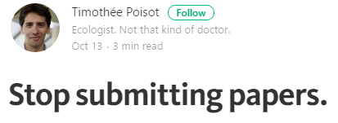
Une révolution de la publication?
https://medium.com/@tpoi/stop-submitting-papers-32db87b3f975#.d9b0w28ko

Slide 19
Les « preprints »
Accès ouvert
Revisions collaboratives
Publication (DOI)
Établir la priorité
Une révolution de la publication?
Jeremy M. Berg et al. Science 2016;352:899-901
Notes:
Peer review and preprints. Preprints accelerate dissemination, whereas manuscripts are being improved through peer review.

Slide 20
Super! mais c’est légal?
1) Pre-print → La quasi totalité
2) Post-print → La grand majorité
3) PDF version
Comment verifier?
http://www.sherpa.ac.uk/
Jeremy M. Berg et al. Science 2016;352:899-901
Notes:
Peer review and preprints. Preprints accelerate dissemination, whereas manuscripts are being improved through peer review.

Slide 21
Super! mais c’est légal?
1) Pre-print → La quasi totalité
2) Post-print → La grand majorité
3) PDF version
Comment verifier?
http://www.sherpa.ac.uk/
Jeremy M. Berg et al. Science 2016;352:899-901
Notes:
Peer review and preprints. Preprints accelerate dissemination, whereas manuscripts are being improved through peer review.

Slide 22
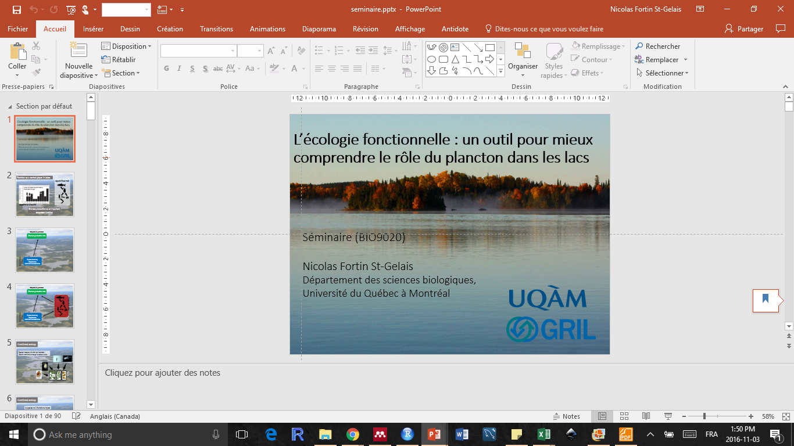



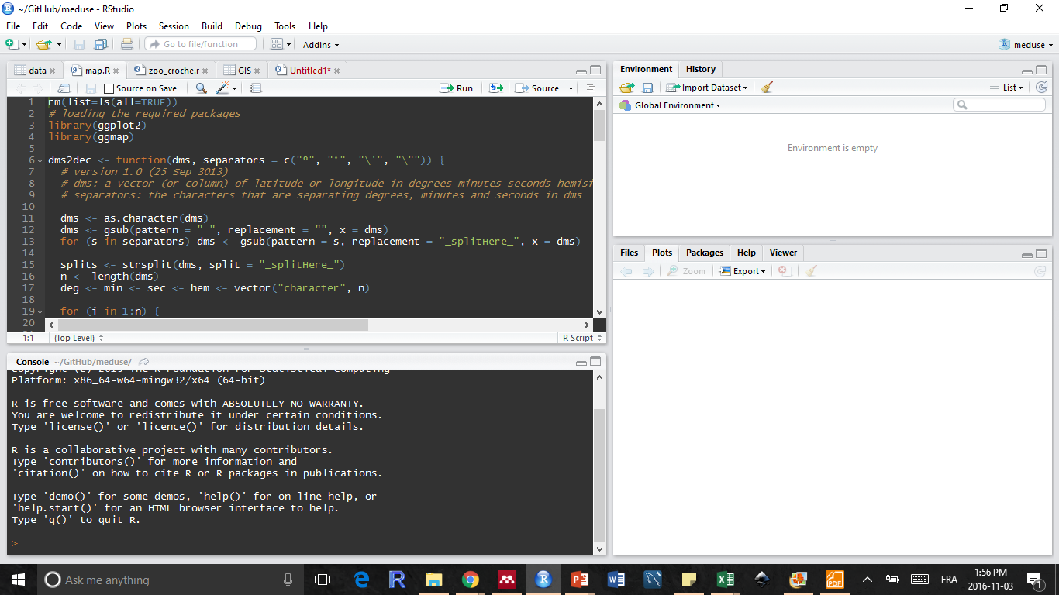

Slide 25
Les données ouvertes

Slide 26

Pourquoi ouvrir mes données?
1
2
3
4
Imputabilité/
Réplicabilité
Favoriser les
Collaborations
Efficacité/visibilité de
la recherche
GBS
(Gros Bon Sens)
Crainte….
Qualité des données
Notes:
Boring reasons
But what opening my data can do for me….

Slide 27


Comment ouvrir mes données?
Analyses
Données
Propriété

Slide 28

Comment ouvrir mes scripts?
Analyses
Propriété

Slide 29


À plus petite échelle

Slide 30
À plus petite échelle

Slide 31
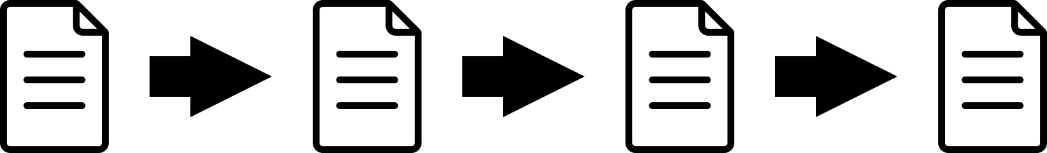
Apprendre de l’histoire L’archivage des version précédentes
Notes:
Want to know what everyone’s been doing? A Version Control System keeps track of every time you update the project. Not only can you see what everyone’s been up to, but it also gives you a way to keep track of the evolution of the project.
/** OUTDATED **/
When you commit changes to a repository, you are asked to make a commit message describing what changes you made. This is then stored in a log file, which also makes note of when the change occurred, who made the changes, what files were changed, and even what those changes were (down to individual lines of code). Through this you can keep a detailed record of the history of the project and evolution of the project.

Slide 32
Une machine à remonter le temps L’archivage des version précédentes
Notes:
Want to know what everyone’s been doing? A Version Control System keeps track of every time you update the project. Not only can you see what everyone’s been up to, but it also gives you a way to keep track of the evolution of the project.
/** OUTDATED **/
When you commit changes to a repository, you are asked to make a commit message describing what changes you made. This is then stored in a log file, which also makes note of when the change occurred, who made the changes, what files were changed, and even what those changes were (down to individual lines of code). Through this you can keep a detailed record of the history of the project and evolution of the project.

Slide 33
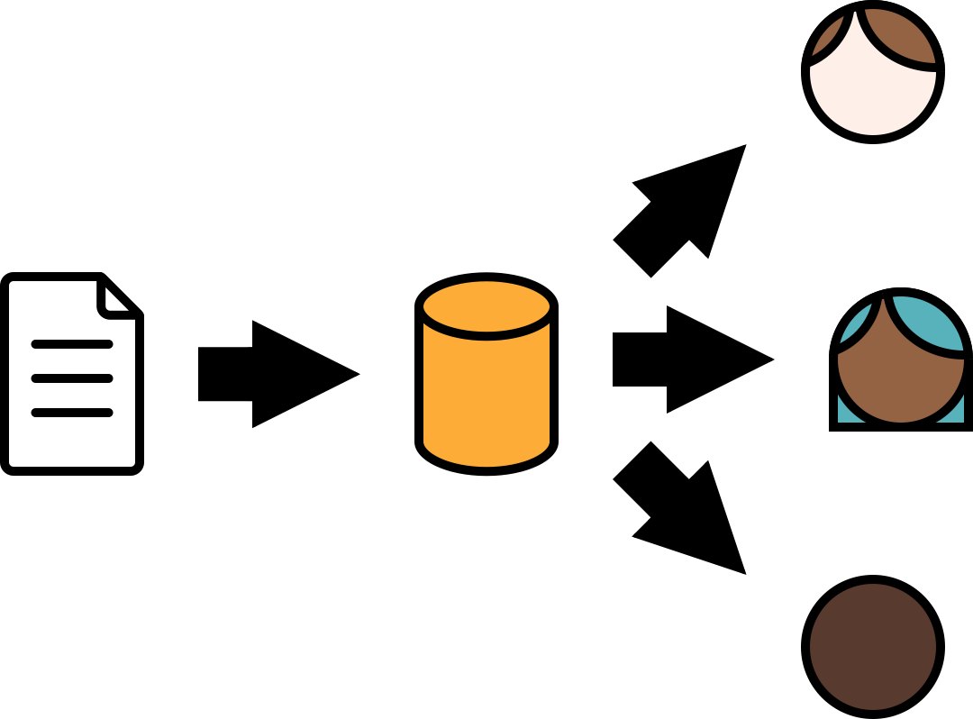
Idéal pour le partage de données et scripts
Notes:
That’s great and all, but if you do change something, how do you make sure everyone gets it?
With Version Control, you can create a shared repository on a server. If you change a file, you can upload it to the server through a commit. The rest of the group can then pull that change and have an up-to-date version of the project. Some IDEs like Visual Studio can do this automatically.
/** OUTDATED **/
Version control helps with collaboration. Users can create a repository where they can commit any changes. Once on there, other users can pull the files from that repository. This works both ways. These users can then make their own changes and commit their changes to the repository as well

Slide 34
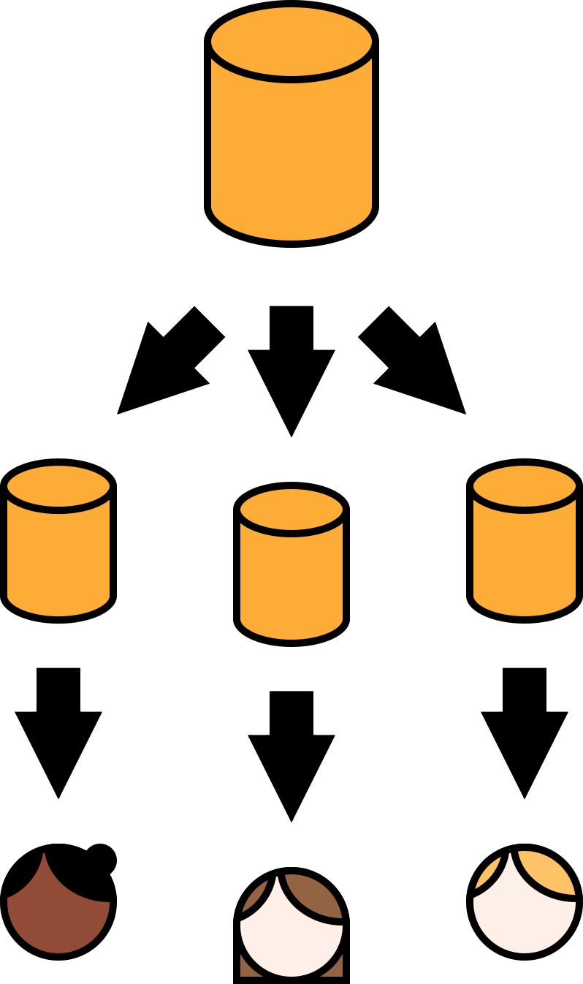
Idéal pour le partage de données et scripts
Notes:
That’s great and all, but if you do change something, how do you make sure everyone gets it?
With Version Control, you can create a shared repository on a server. If you change a file, you can upload it to the server through a commit. The rest of the group can then pull that change and have an up-to-date version of the project. Some IDEs like Visual Studio can do this automatically.
/** OUTDATED **/
Version control helps with collaboration. Users can create a repository where they can commit any changes. Once on there, other users can pull the files from that repository. This works both ways. These users can then make their own changes and commit their changes to the repository as well

Slide 35
RopenSci
https://ropensci.org/

Slide 36
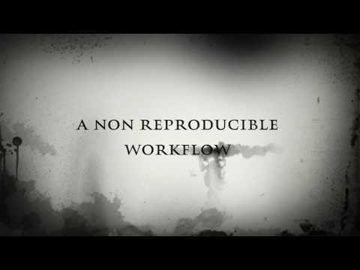

Slide 37
RopenSci
https://ropensci.org/

Slide 38
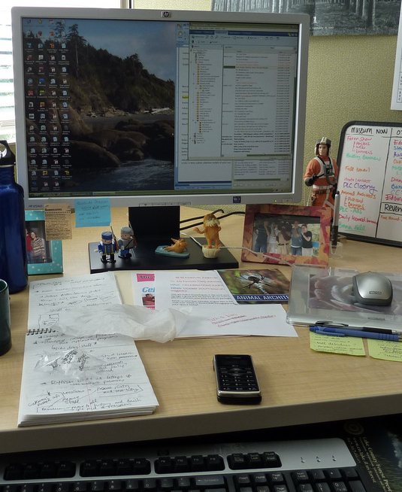
Comment en apprendre plus?

Slide 39

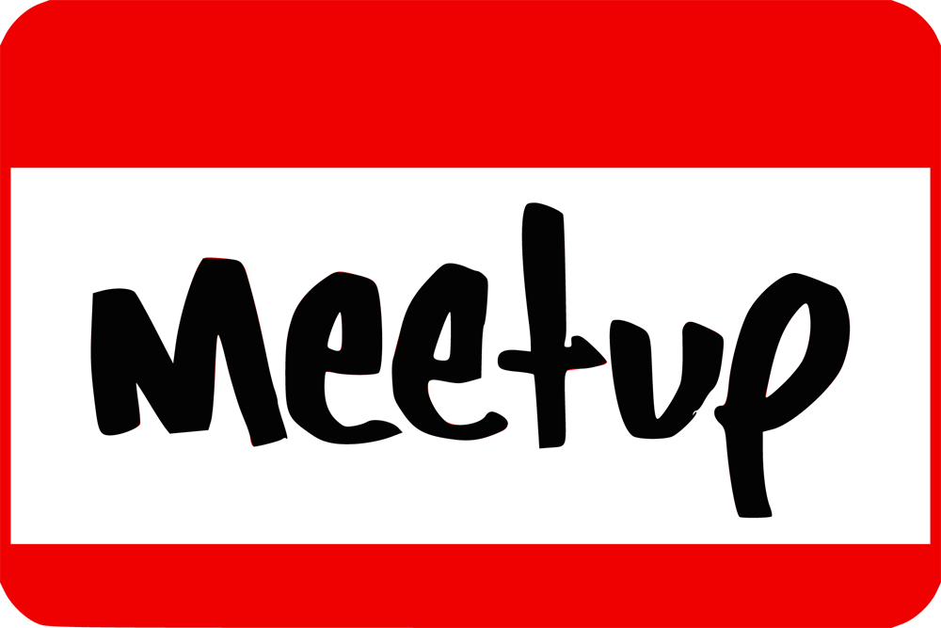
Community Calls Second Thursday of every other month, 11am ET and study groups
Comment en apprendre plus?
Open data online handbook:
https://mozillascience.github.io/open-data-primers/index.html

Slide 40


Comment en apprendre plus?

Slide 41
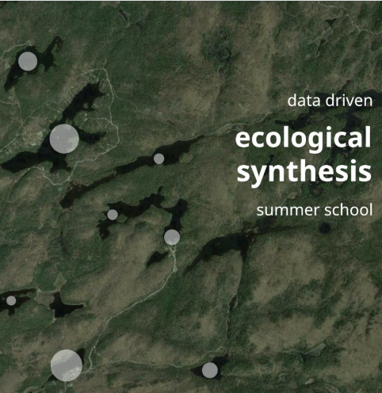
Comment en apprendre plus?
http://poisotlab.io/summerschool/

Slide 42
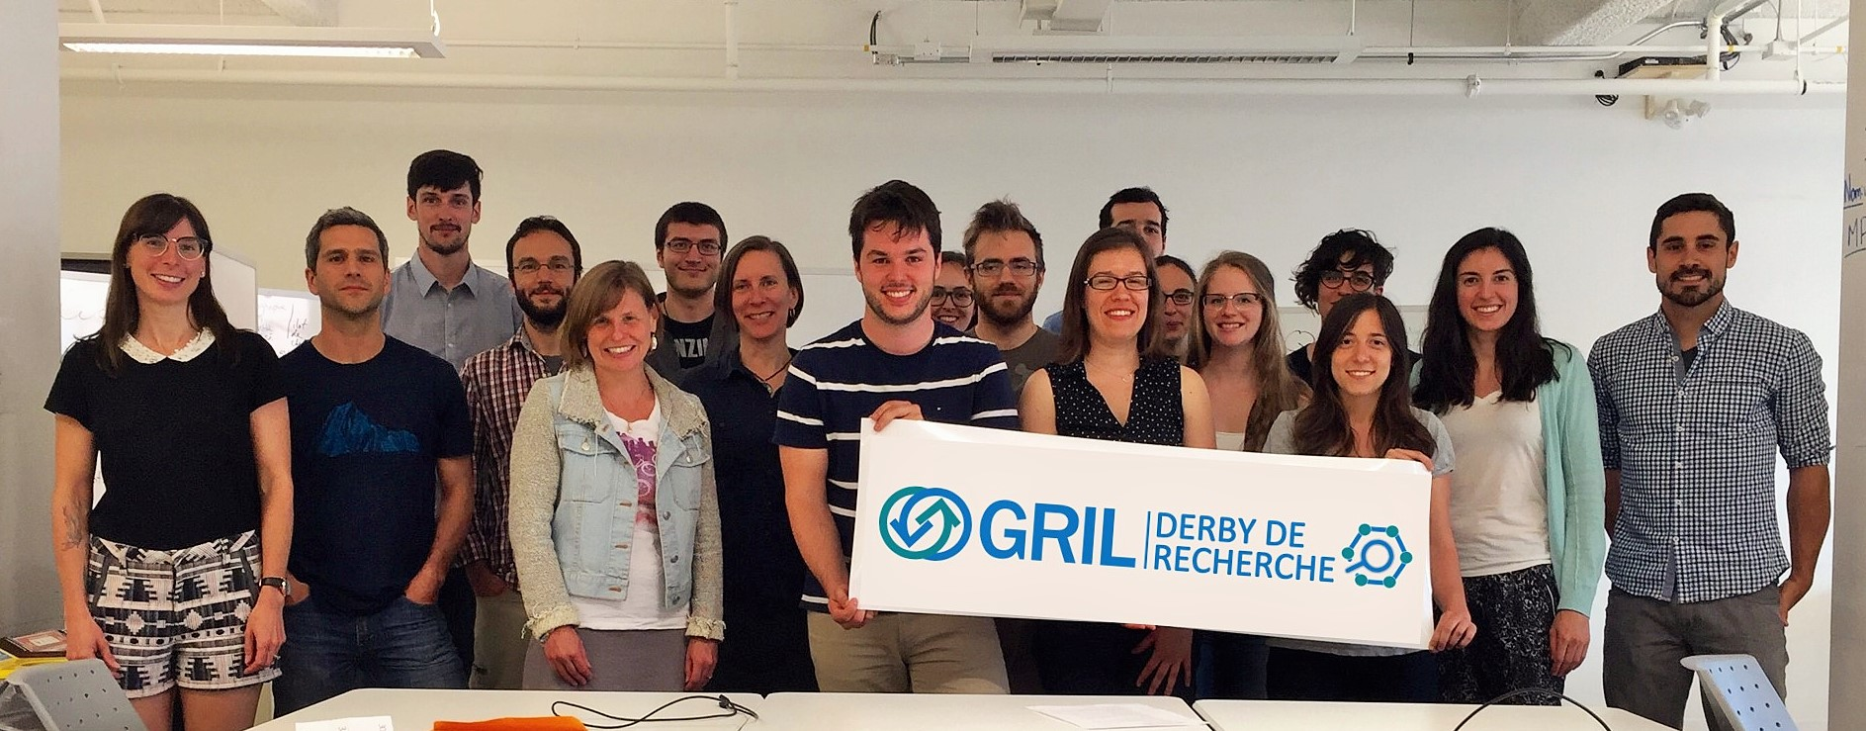
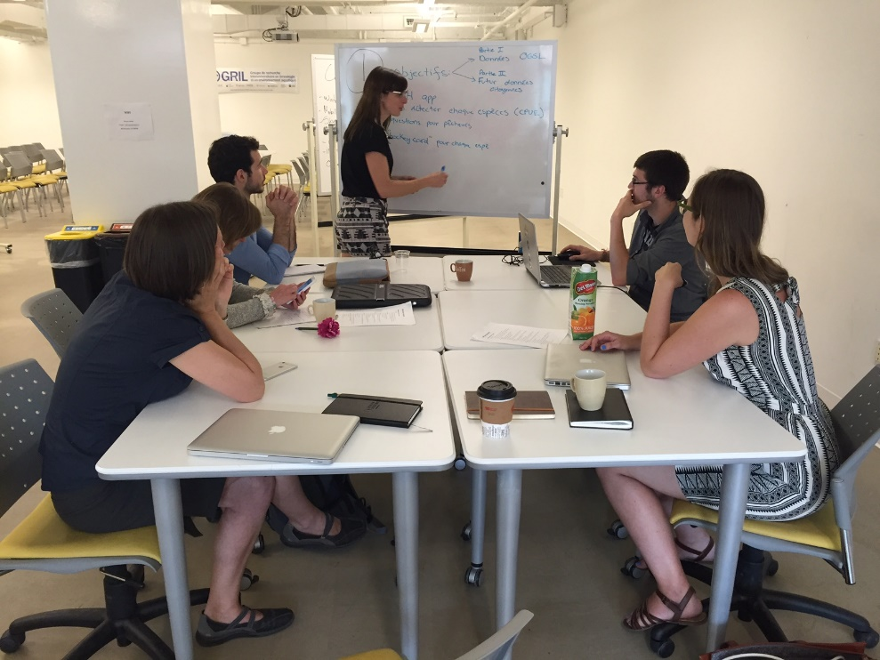
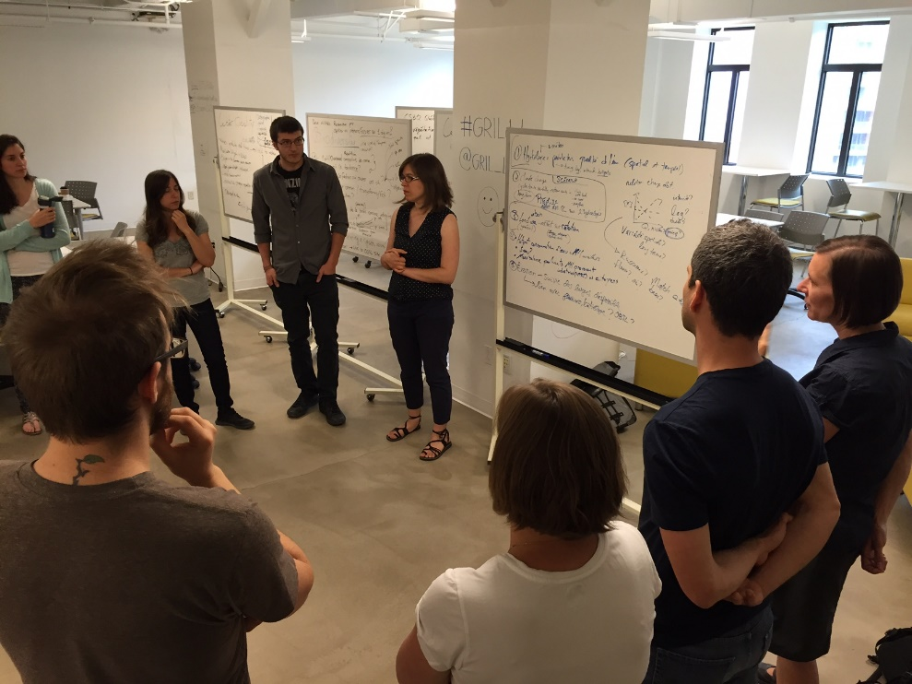
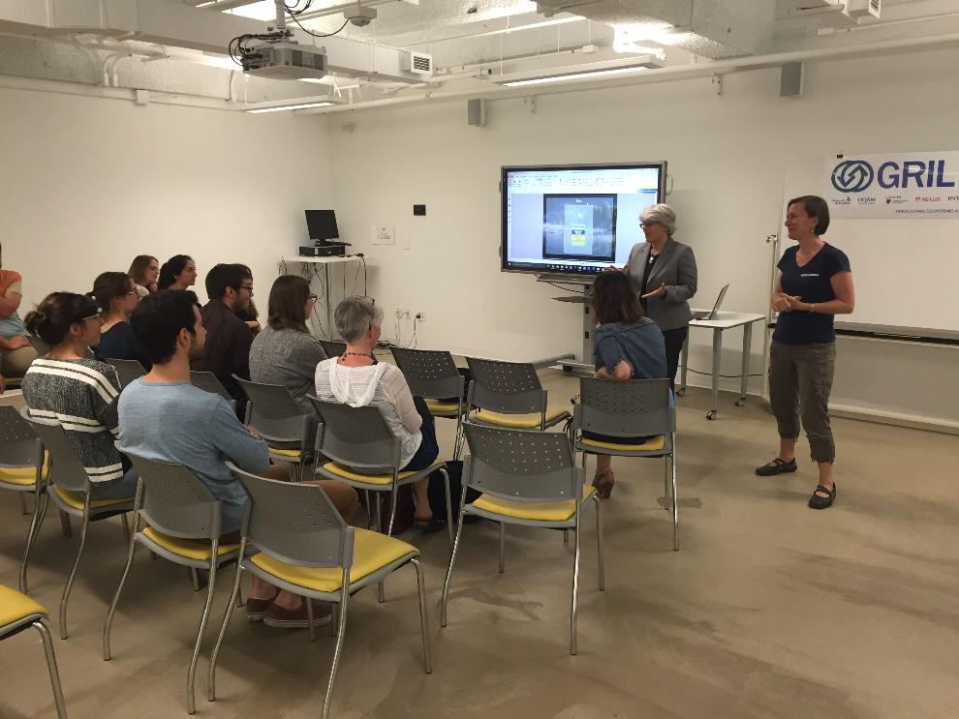
Comment en apprendre plus?

Slide 43

Comment en apprendre plus?
Flickr: Szoki Adams

Slide 44
Icon made by
Freepik from www.flaticon.com
Pixel Buddha from www.flaticon.com
Madebyoliver from www.flaticon.com

